Slide 1

GROUP MEMBERS: SHANKARASUBRAMANIYAN GANAPATHI SUBRAMANIAN SAI PUNEETH CHINNAM PIYUSH KUMAR SULTANIA BISMITA BEHRA
FLIGHT BOOKING MANAGEMENT SYSTEM

Slide 2
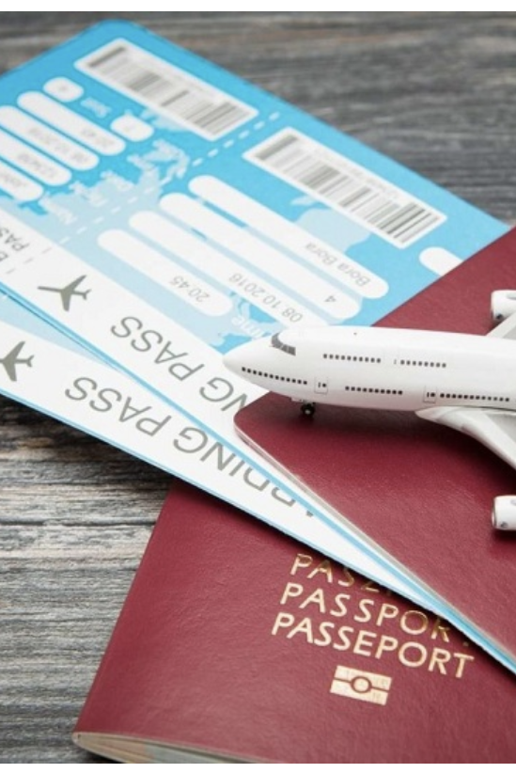
OBJECTIVE
This project aims at enhancing the relationship between the customers and airlines via the Flight Reservation System.
The system allows a passengers to perform various functions such as managing the flight bookings, and customer information.
Incorporate the COVID-19 digital test reports and vaccination details of the passengers for convenient and a safe journey.

Slide 3
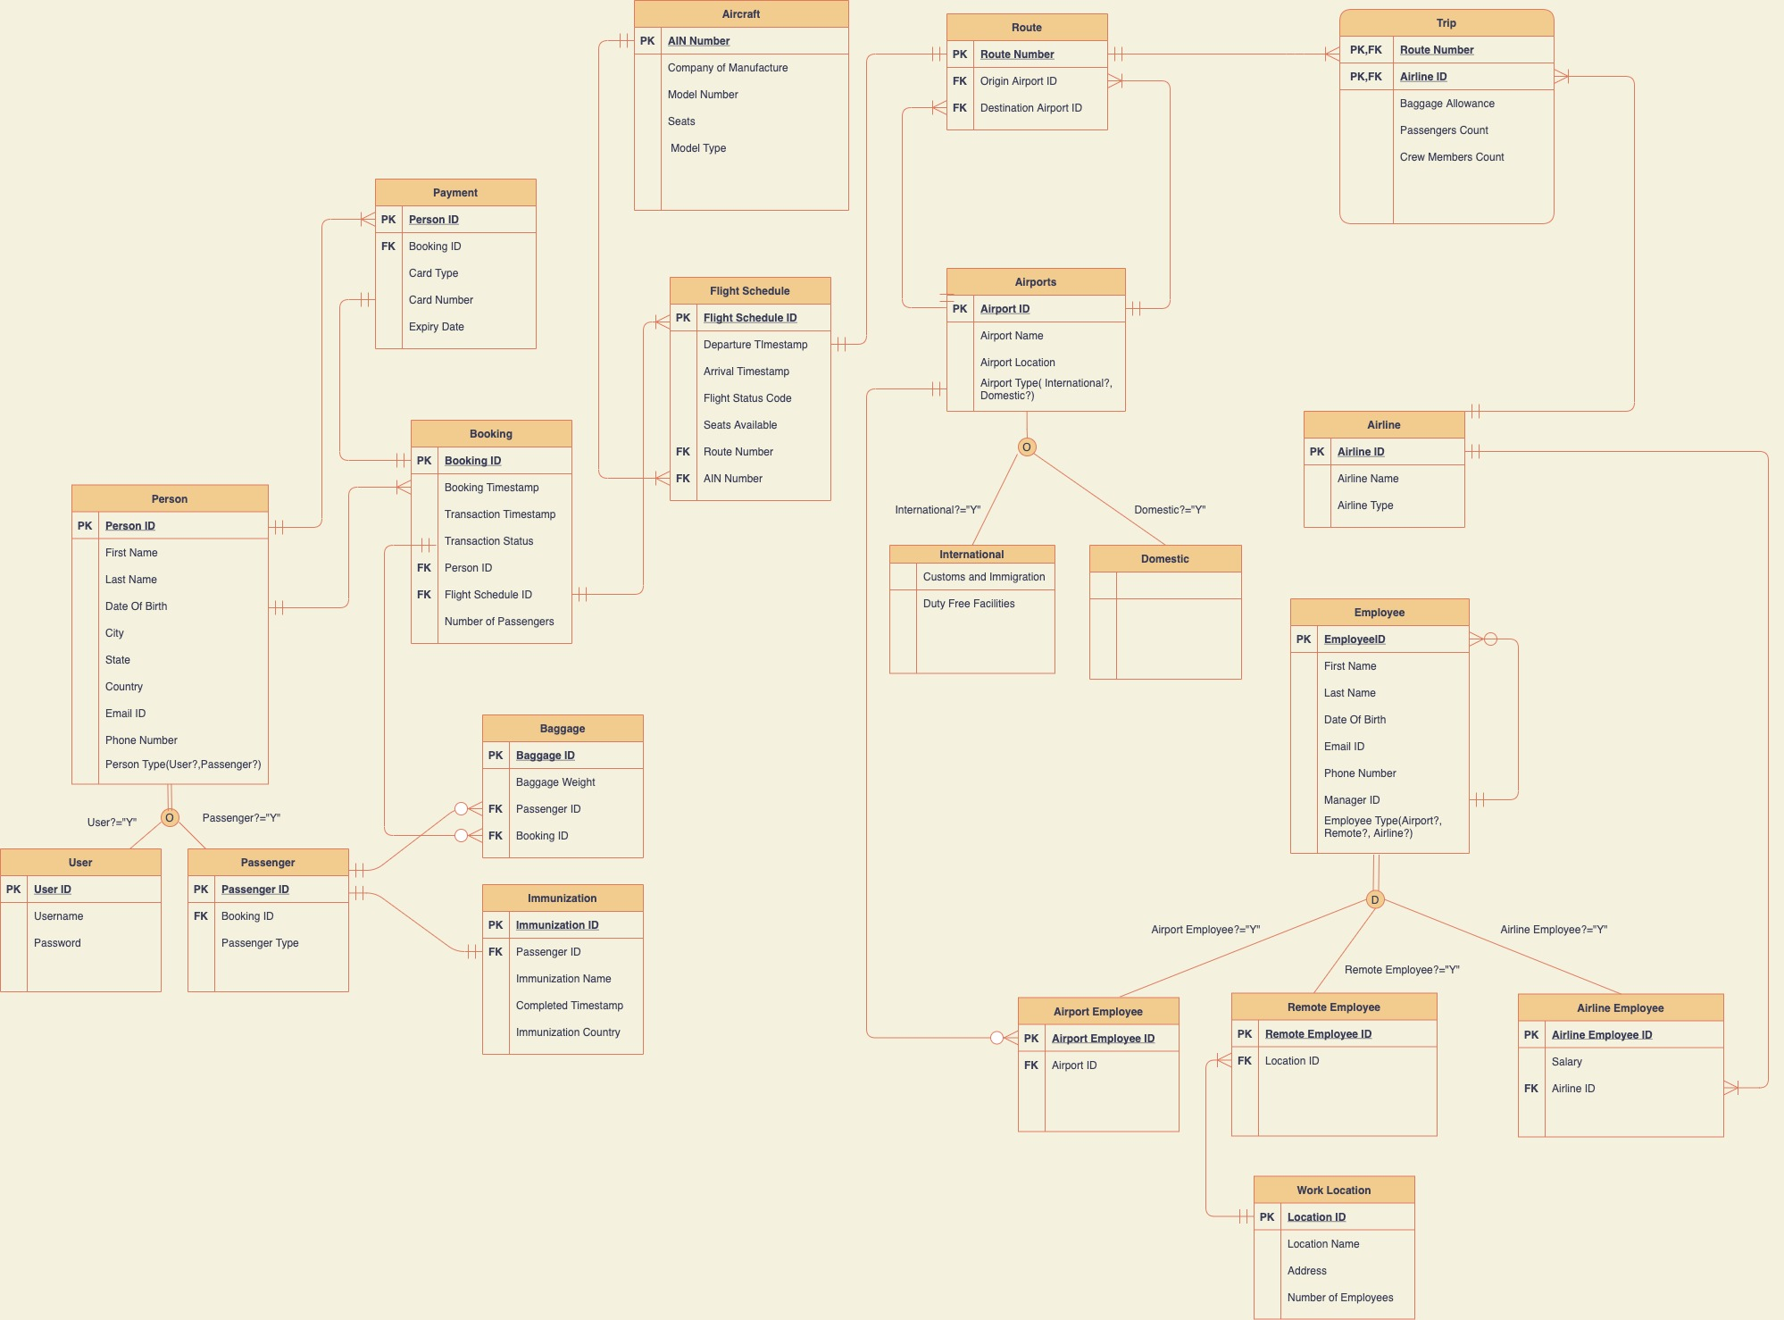

Slide 4

Design document
A total of twenty entities have been created and corresponding relationships have been established in the best possible normalized form which is suited for a database.
Attaching the design document with the entities, attributes with the description for each entity.

Slide 5

SQL STATEMENTS
Twenty tables have been created with each table containing 10 records.
The tables present in the database have table level check constraints, clustered and non clustered indexes, encryption in column, computed columns.
Corresponding stored procedures, triggers and views have ben created with the available data from the database

Slide 6
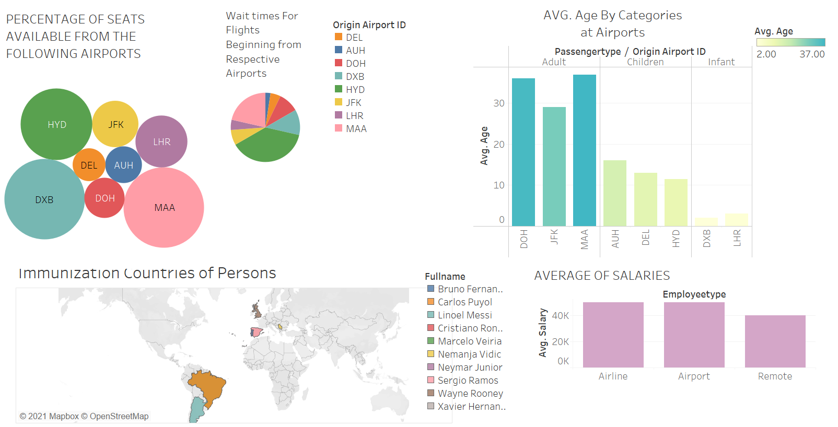

Slide 7
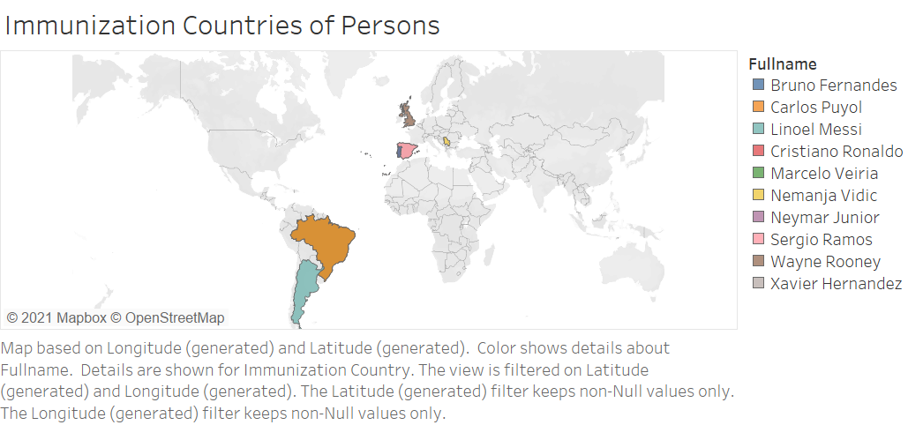
This map depicts the countries in which “PERSONS” got vaccinated.

Slide 8
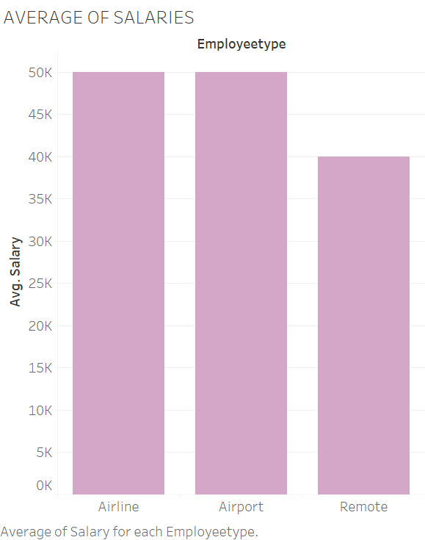
The Bar graph compares the average salaries of the respective employee types.

Slide 9
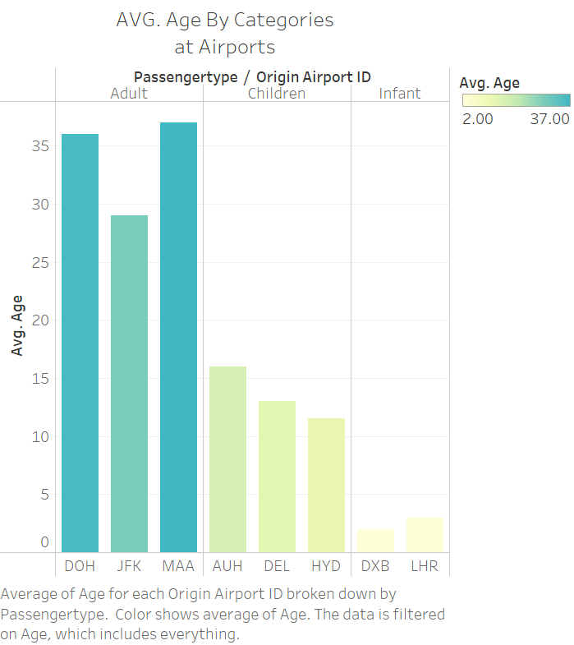
This is Average age of passengers at their respective Origin Airports.

Slide 10
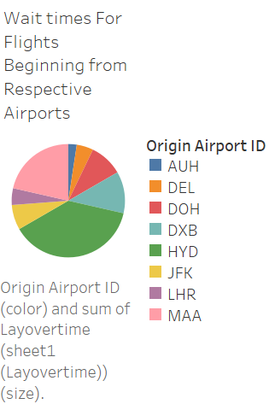
Average wait time for passenegers at their respective origin airports

Slide 11
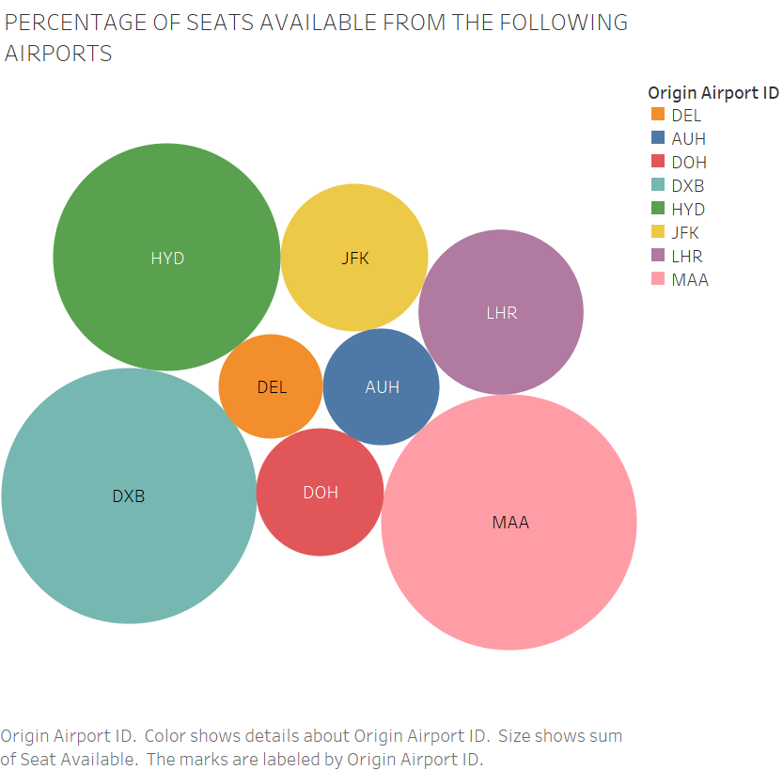
This shows the respective seats available to “Boston Logan International Airport” from these respective airports.

